Slide 1
QUALITY
P.Ramya, Assistant Professor,Department of IT,VRSEC.

Slide 2
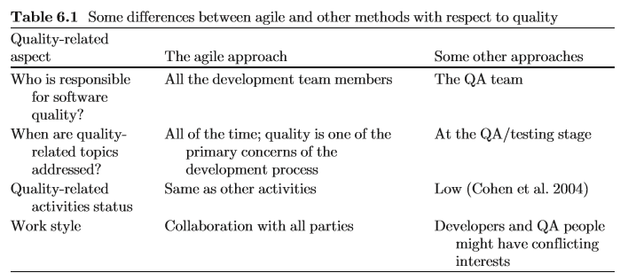
The Agile Approach to Quality Assurance
P.Ramya, Assistant Professor,Department of IT,VRSEC.

Slide 3
The Agile Approach to Quality Assurance
Process Quality
    Transparency
    - Tightness
Product Quality
    Refactoring (code quality)
    Pair –Programming (code inspection)
    Acceptance Tests
    Test Driven Development (TDD) (programming technique)
P.Ramya, Assistant Professor,Department of IT,VRSEC.

Slide 4
Test Driven Development (TDD)
It is a Step-by –Step development of a specific functionality together with its unit test.
It is a programming technique to provide clean & fault –free code.
First we Write the test case and then we write the code that enables the test case to pass.
We also perform refactoring here.
P.Ramya, Assistant Professor,Department of IT,VRSEC.

Slide 5
How TTD overcomes the problems of normal testing?
Not enough time to test
Testing Provides negative feedback
Responsibility for testing is transferred
Testing is a low-status job
Testing is hard to manage
Testing is hard
P.Ramya, Assistant Professor,Department of IT,VRSEC.

Slide 6
Advantages given by developers after implementing TTD
‘‘It makes us think ahead.’’
‘‘There are less bugs. Developers are forced to produce high-quality software.’’
‘‘It helps us get acquainted with the software components.’’
P.Ramya, Assistant Professor,Department of IT,VRSEC.

Slide 7
Advantages given by developers after implementing TTD
‘‘It makes us think before coding.’’
‘‘It requires writing minimum code in order to let the tests pass.’’
‘‘It saves time that used to be dedicated to bug finding.’’
‘‘It helps in quality assurance!’’
P.Ramya, Assistant Professor,Department of IT,VRSEC.

Slide 8
Disadvantages given by developers after implementing TTD
‘‘Work is delayed because of relatively simple items.’’
‘‘It doubles the time to write code.’’
‘‘It increases development time.’’
‘‘There is no global view when dealing with complicated components.’’
P.Ramya, Assistant Professor,Department of IT,VRSEC.

Slide 9
Disadvantages given by developers after implementing TTD
‘‘It is hard to identify the critical cases.’’
‘‘It is not suitable for every kind of task.’’
‘‘It is a waste of time if the code is not used later.’’
P.Ramya, Assistant Professor,Department of IT,VRSEC.

Slide 10
Measured TDD
Aims to improve the performance of TDD by adding measures and control.
Size: No.of lines of code
Complexity: Cyclomatic complexity
Measured TDD: Measured while developing.
P.Ramya, Assistant Professor,Department of IT,VRSEC.

Slide 11
Quality in Learning Environments
Size and Complexity Measures
line of test > TDD steps > Feature
Teaching and Learning Principles:
    Let the learners experience the software development approach
    Elicit communication
P.Ramya, Assistant Professor,Department of IT,VRSEC.

